Slide 1
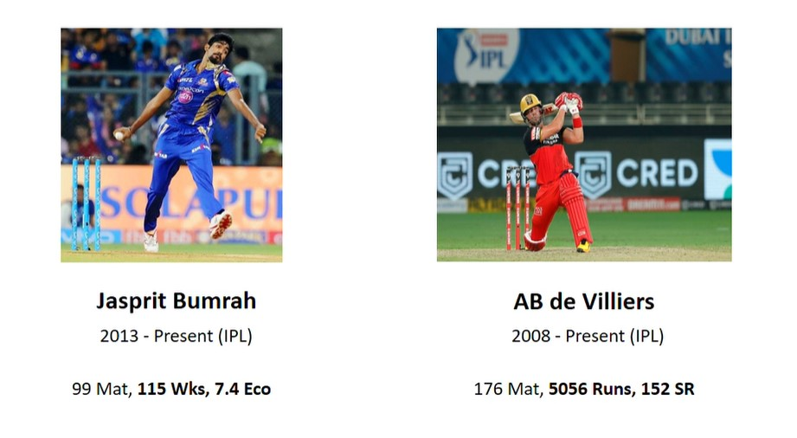
ABD VS BUMRAH
MR.360 AGAINST BOOM BOOM

Slide 2
MATCH UP:
AB de VILLIERS vs BUMRAH(only ipl)
BALLS:79
RUNS:114
OUTS:2
SR:144

Slide 3
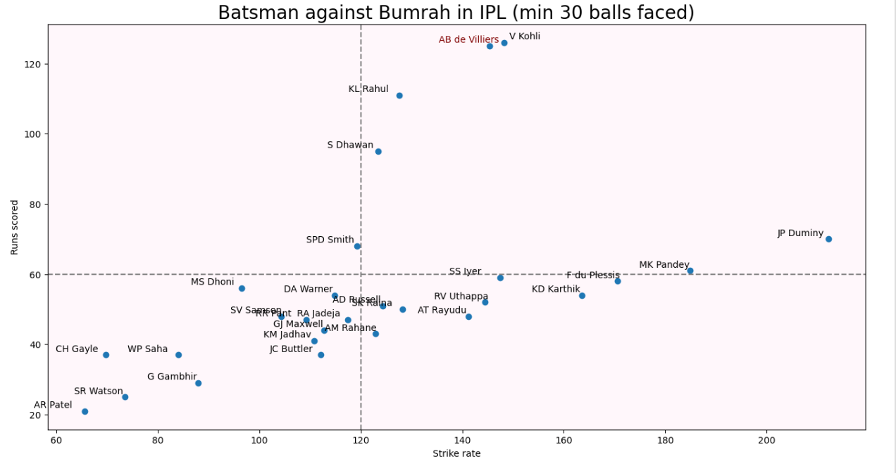
SUMMARY AND CONCLUSION(1/2):

Slide 4
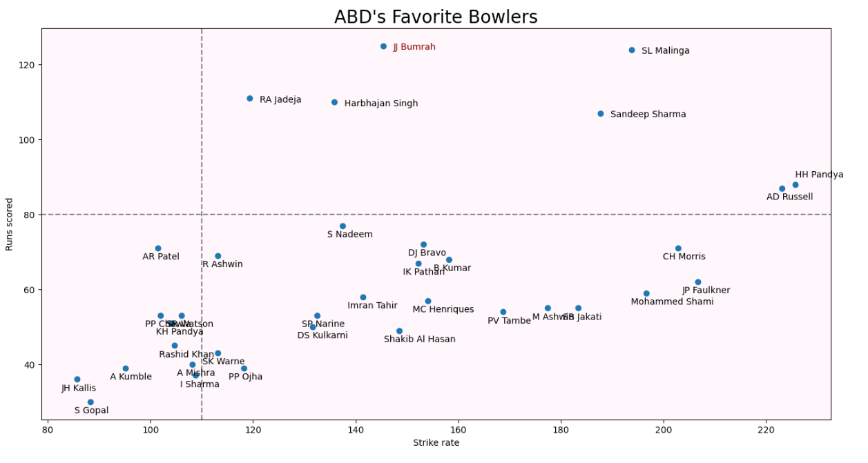
SUMMARY AND CONCLUSION(2/2):

Slide 5
CONCLUSION:
CLEARLY AB WINS THE BATTLE AGAINST BUMRAH!

